Slide 1

R.M.K. COLLEGE OF ENGINEERING AND TECHNOLOGY DEPARTMENT OF ELECTRONICS AND COMMUNICATION ENGINEERING
B.E – PROJECT REVIEW- DATE: 30/09/2026
TITLE:
DESIGN AND IMPLEMENTATION OF OPTIMIZED RISC V PROCESSOR USING CUSTOM MAC INSTRUCTION
By
ANISH V S 111623104007
SRI PRASANNA PRIYAA M 111623104095
SUPERVISOR
Ms. C.NITHIYA
ASSISTANT PROFESSOR

Slide 2
CONTENTS
Objectives
Introduction
Literature Review
Problem Statement
Proposed Work
Simulation Tool
Work Plan
Conclusion
Reference

Slide 3
OBJECTIVES
To study the RISC-V ISA and processor architecture, with emphasis on RV32-based embedded processors.
To analyze the performance bottlenecks associated with repetitive Multiply-Accumulate (MAC) operations.
To design and integrate an application-specific custom MAC instruction into a RISC-V processor.
To develop a dedicated hardware MAC unit for accelerating compute-intensive operations.

Slide 4
INTRODUCTION
RISC-V is an open and modular Instruction Set Architecture (ISA) that supports application-specific instruction extensions.
The flexibility of RISC-V enables the integration of custom instructions and dedicated hardware accelerators to improve processor performance.
Multiply-Accumulate (MAC) is a fundamental operation in DSP and compute-intensive applications such as FIR filtering, dot-product computation and matrix operations.
Conventional execution of MAC operations requires multiple instructions, resulting in increased instruction count, execution cycles and processing time.
A custom MAC instruction can combine multiplication and accumulation into a single application-specific operation, reducing computational overhead.
This project proposes the design and FPGA implementation of a performance-optimized RISC-V processor with a custom MAC instruction.
The proposed processor will be implemented and evaluated on the Xilinx PYNQ-Z2 FPGA using Vivado.
Core Concept:
RISC-V Processor → Custom MAC Instruction → Hardware MAC Unit → PYNQ-Z2 → Performance Evaluation
MAC=(A×B)+C

Slide 5
LITERATURE REVIEW
S.No | Year | Author | Title | Name of Journal | Performance metrics
1 | 2026 | S.Hemajothi, S.Jalaja, M.Kishore, S.Gowtham Kumar | Design and Implementation of a Custom-MAC Instruction in Open-Source RISC-V Processor Core | IEEE ICCPCT 2026 | Custom MAC in PicoRV32 using PCPI; 2× speedup, ~3–5% area overhead, ~100 MHz FPGA, power not reported
2 | 2024 | S. Wang, X. Ding, Y. Yang | Tracking Accelerator Based on RISC-V Custom Instructions for GNSS Receiver | IEICE Electronics Express | 58–94% speed increase for tracking loops; 122–700% speed increase for custom instructions; 33.1% area and 19.8% power increase
3 | 2026 | I. Ahmad, H. Cheng, J. Groszschaedl, D. Page | Extending RISC-V to Support Flexible-Radix Multiply-Accumulate Operations | IACR Communications in Cryptology | Up to 1.5×/1.6× improvement on RV32I; up to 1.3×/1.7× on RV64I for evaluated workloads
4 | 2025 | M. Sabih et al. | Hardware/SoftwareDesign of RISC-V for Accelerating Sparse DNNs in FPGAs | FPGA / RISC-V research | Up to 3×, 4× and 5× speedups for different sparse-DNN configurations

Slide 6
PROBLEM STATEMENT
To design and implement a custom MAC instruction in a RISC-V processor to reduce the execution overhead of MAC-intensive workloads and evaluate its performance, timing, FPGA resource utilization and power consumption on the PYNQ-Z2 platform.
MAC operations are frequently used in computationally intensive applications such as FIR filtering, dot-product and matrix operations.
In a conventional RISC-V processor, a MAC operation requires multiple arithmetic instructions, increasing the instruction count and execution cycles.
Repeated execution of these operations can lead to increased execution time and computational overhead.
Although RISC-V supports custom instruction extensions, designing an application-specific instruction requires careful consideration of the processor datapath, FPGA resources and performance benefits.
Therefore, there is a need for a lightweight custom MAC instruction that can accelerate MAC-intensive workloads while maintaining reasonable FPGA resource utilization.
Existing accelerator-based approaches are often designed for specific applications and may introduce additional hardware resource and power overhead.

Slide 7
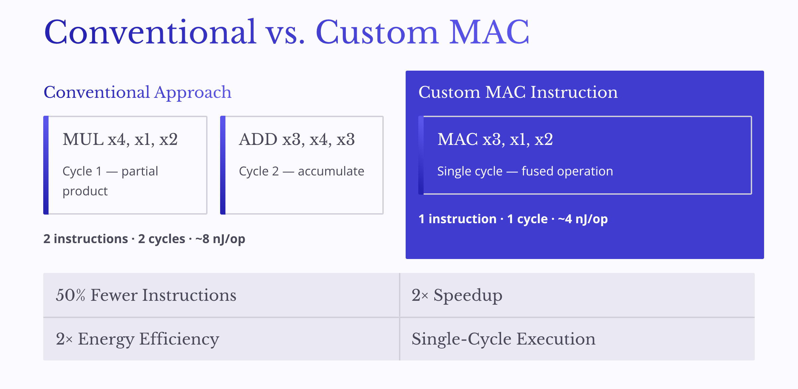
Custom MAC Instruction for RISC-V:
A single-cycle Multiply-Accumulate extension that halves instruction count, doubles throughput, and cuts energy per operation in half — all within a lean FPGA footprint.

Slide 8
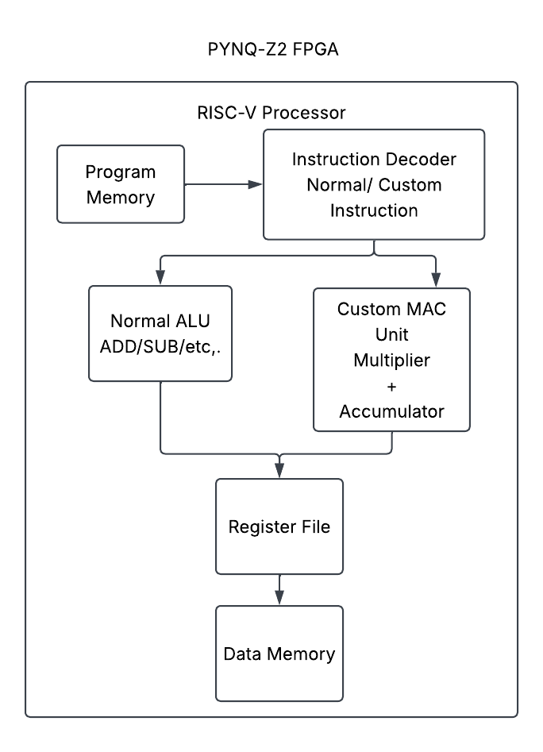
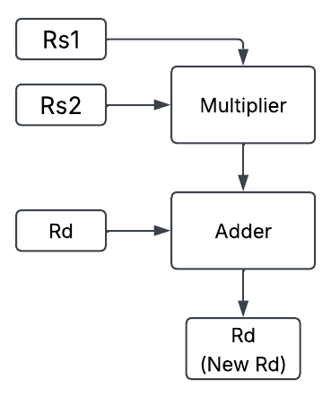
PROPOSED WORK
Block Diagram:
MAC Operation:
Custom MAC Instruction
Rd​=(Rs1​×Rs2​)+Rd​

Slide 9
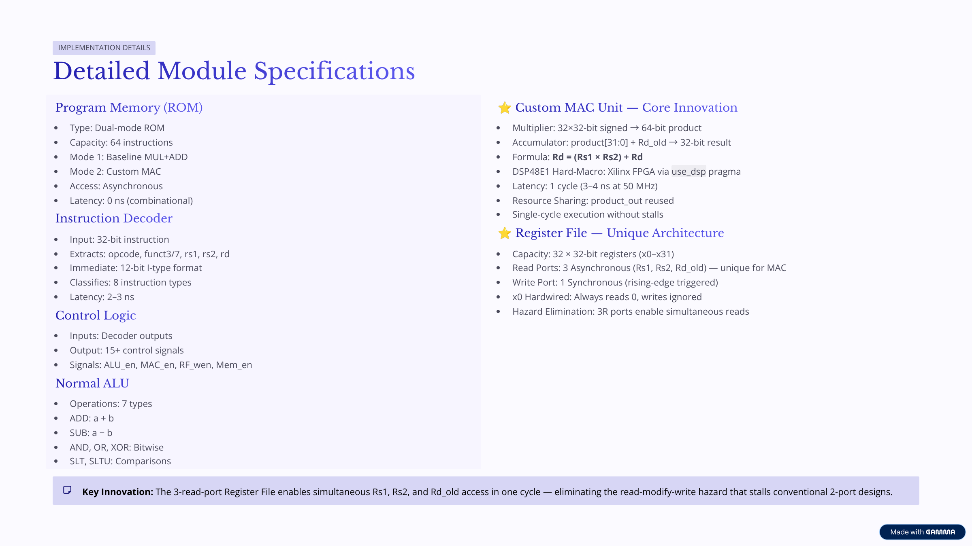

Slide 10
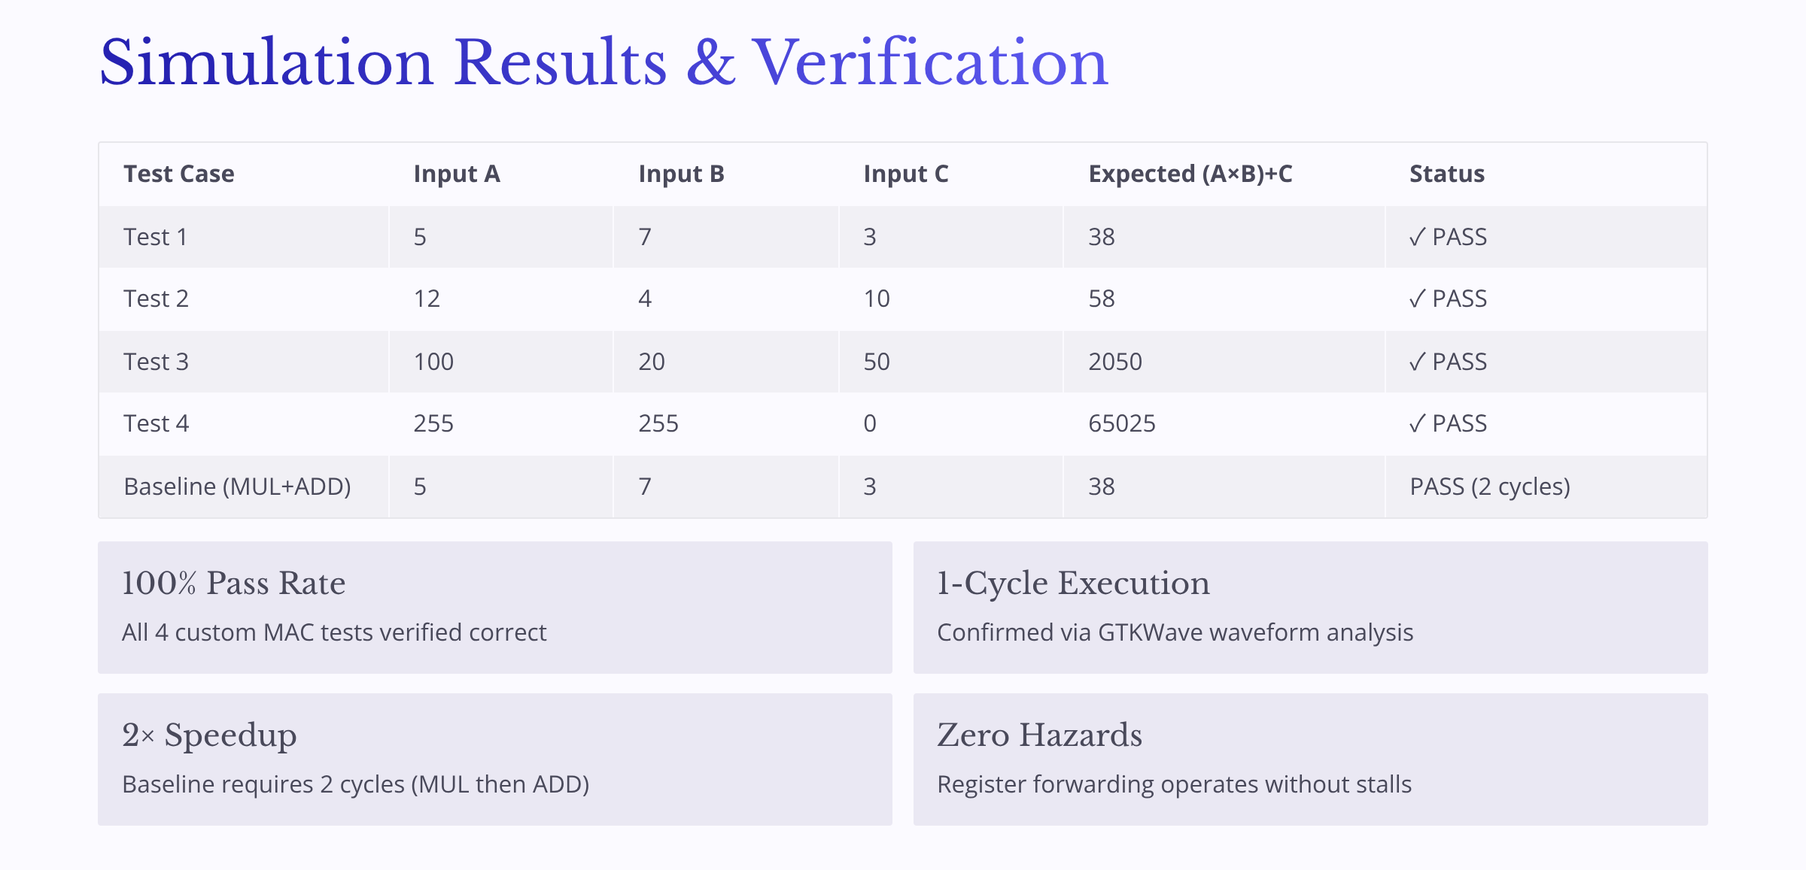
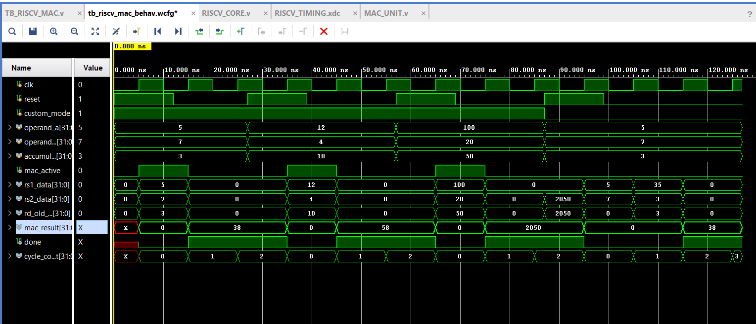

Slide 11
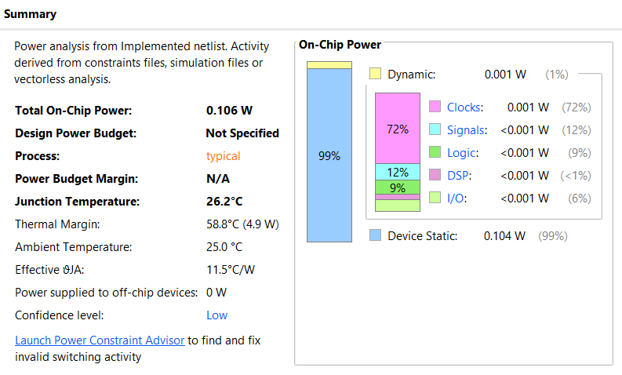
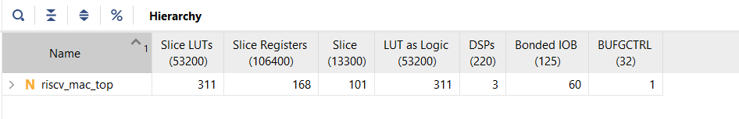
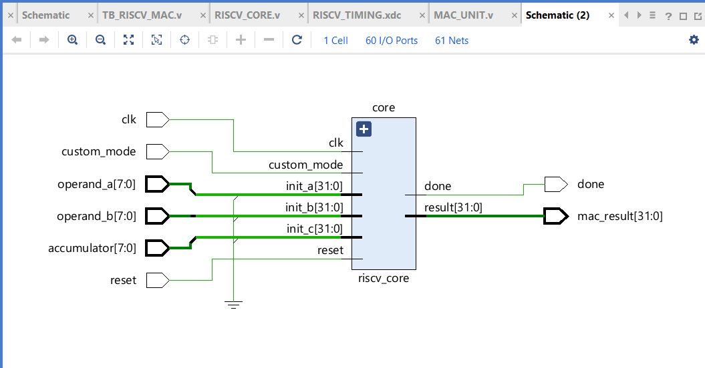
Summary of Power Report
Utilization Report
Schematic

Slide 12
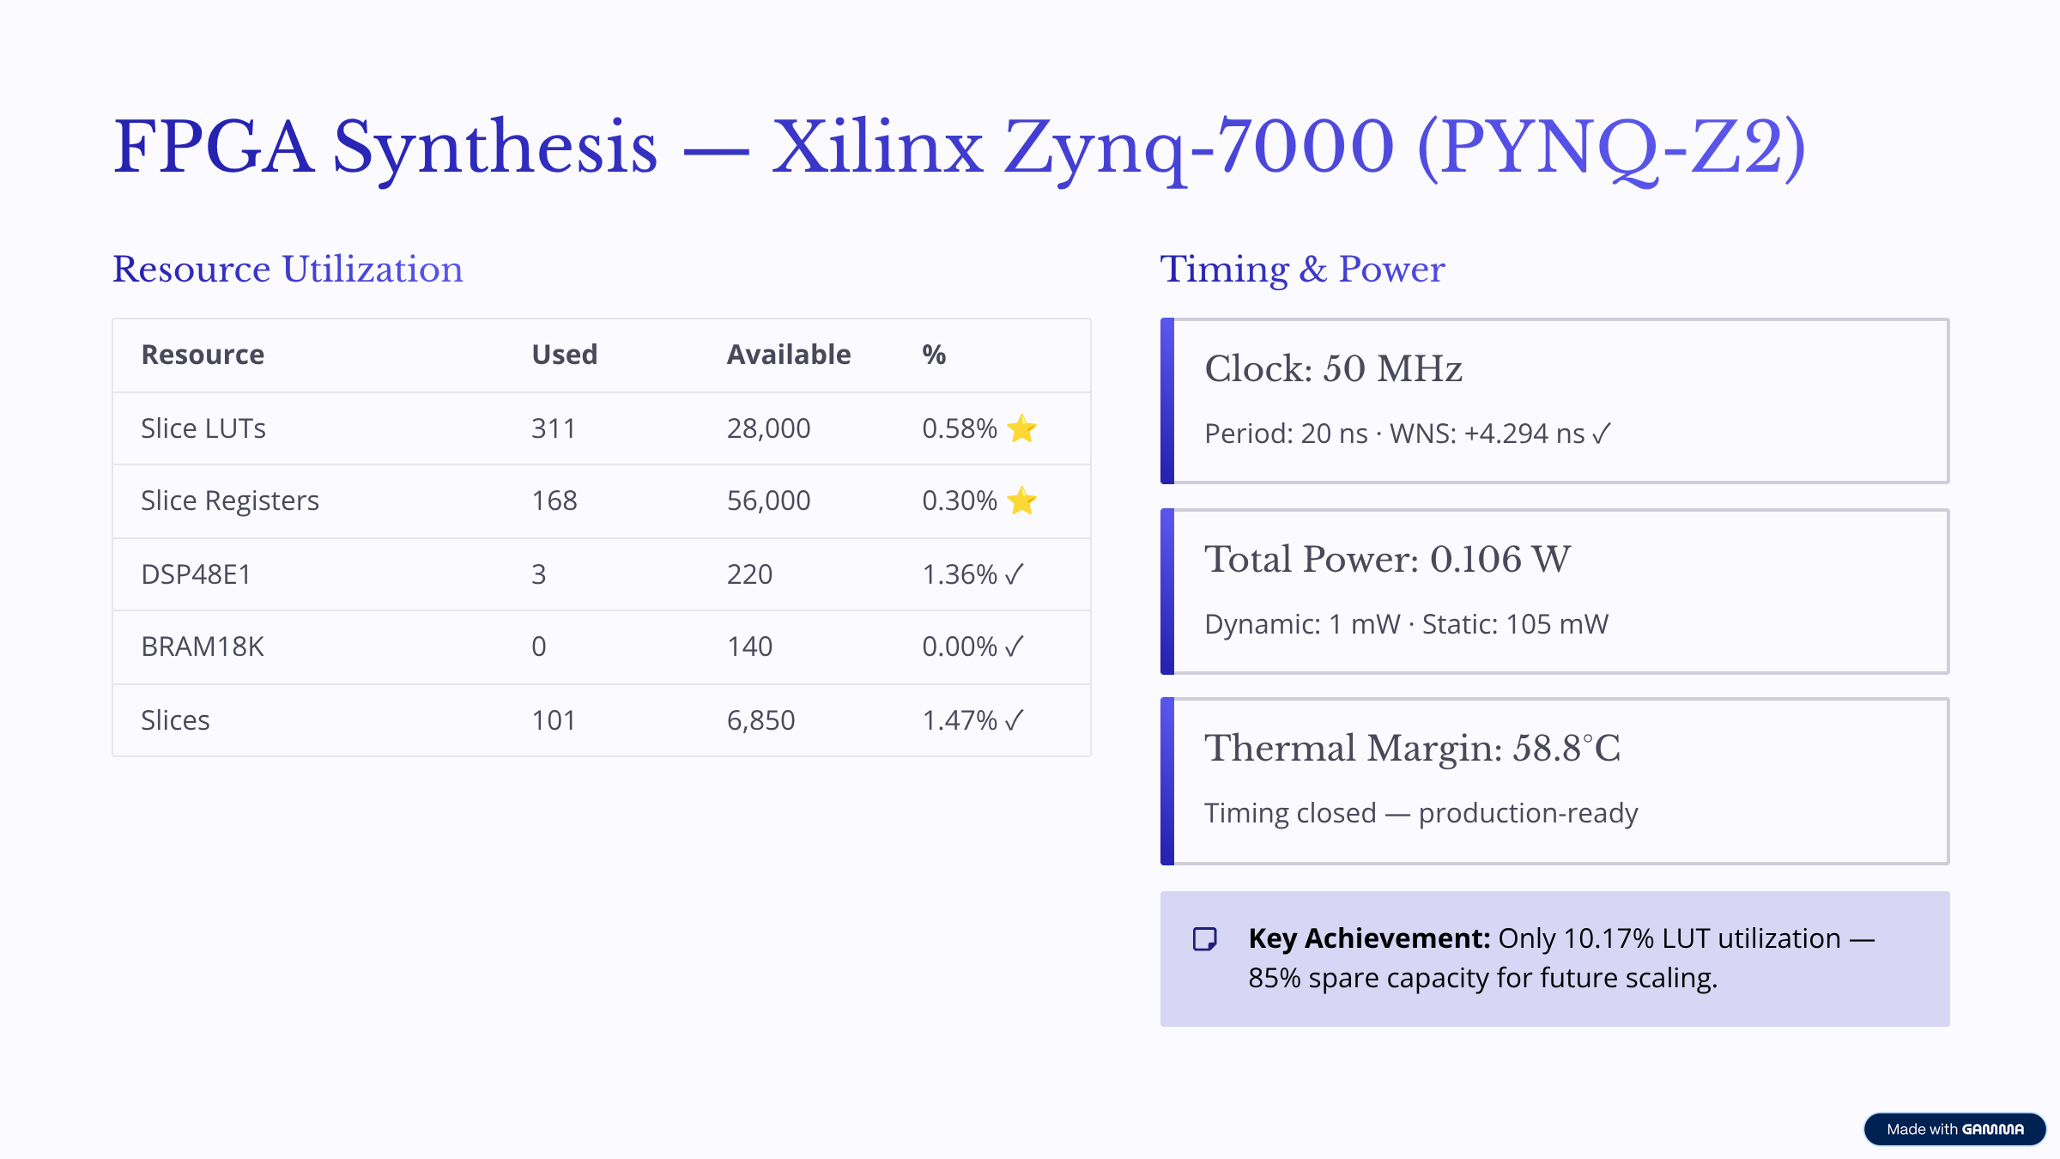

Slide 13
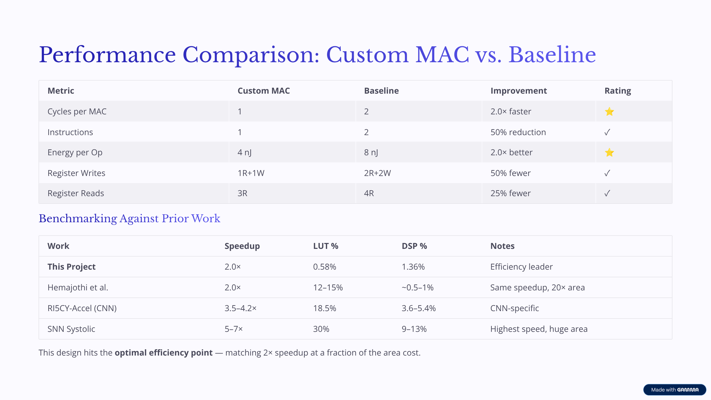

Slide 14
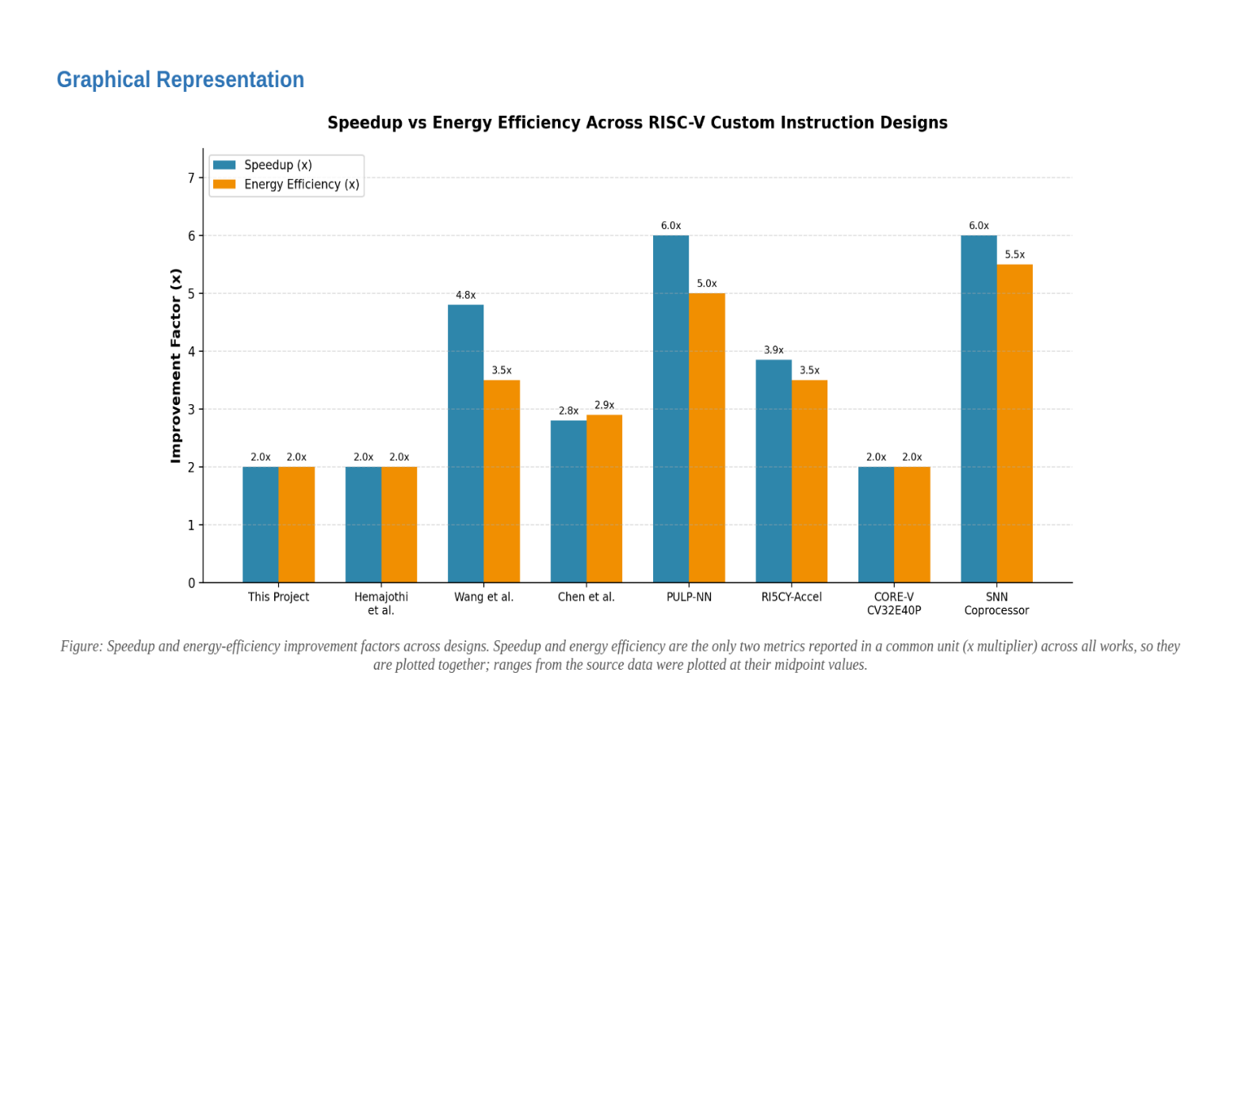
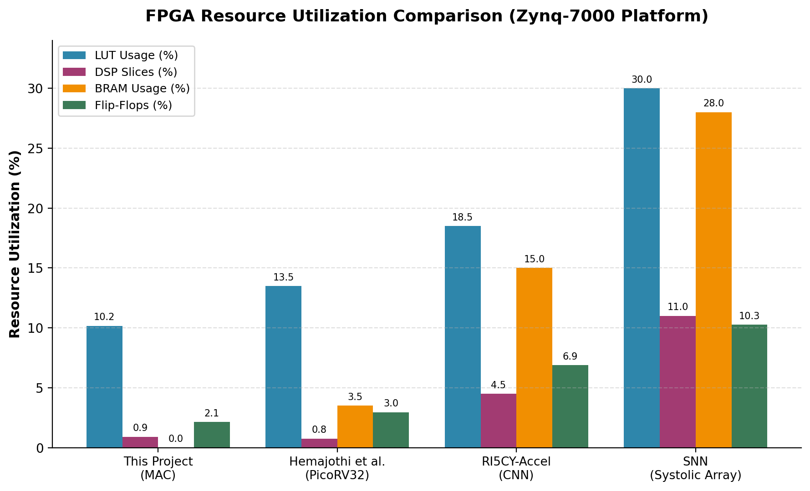
Speedup energy efficiency comparison graph
Graphical Representation of Resourse Utilization

Slide 15
SIMULATION TOOL/ EQUIPMENTS/ COMPONENTS
SOFTWARE REQUIREMENTS:
Tool | Purpose
Xilinx Vivado | RTL synthesis, implementation, timing analysis and FPGA resource utilization
Vivado Simulator | Functional and RTL simulation of the RISC-V processor and custom MAC unit
Verilog / SystemVerilog | Design of RISC-V processor, instruction decoder and MAC hardware
RISC-V GCC Toolchain | Compilation of C programs and generation of RISC-V machine code
C / RISC-V Assembly | Development of MAC-intensive benchmark programs
GTKWave | Visualization and analysis of simulation waveforms
HARDWARE REQUIREMENTS:
PYNQ-Z2 FPGA Development Board
Parameters to be Evaluated:
Power | Area | Speed

Slide 16
WORK PLAN
Activity/Time Period | September | October - November | December | January | February(1-15) | February(16-28) | March
Literature Survey and Analysis
RISC-V ISA and Processor architectures study
Toolchain, PYNQ-Z2 and Vivado Setup
Baseline RISC-V, Custom MAC Design and Integration
FPGA Implementation and Performance Evaluation
Preparation and Submission of the final report

Slide 17

CONCLUSION
RISC-V provides a flexible and open ISA that enables the development of application-specific custom instructions.
MAC operations are widely used in DSP and compute-intensive workloads, making them suitable for hardware acceleration.
The proposed work aims to integrate a custom MAC instruction and dedicated MAC hardware unit into a RISC-V processor.
The optimized processor will be designed, simulated and synthesized using Xilinx Vivado.
The complete design will be implemented and validated on the PYNQ-Z2 FPGA platform.

Slide 18
REFERENCES
[1] "A RISC-V processor with custom instructions for spiking neural network acceleration," in Proc. IEEE Int. Circuits, 10.1109/ICTA64028.2024.10860426. Technologies and Applications (ICTA), 2024, doi: 10.1109/ICTA64028.2024.10860426.
[2] A. Garofalo, M. Rusci, F. Conti, D. Rossi, and L. Benini, "PULP-NN: A computing library for quantized neural network inference at the edge on RISC-V based parallel ultra low-power clusters," in Proc. IEEE Int. Conf. Electron. Circuits Syst. (ICECS), 2019, pp. 33–36, doi: 10.1109/ICECS46596.2019.8965067.
[3] A. Garofalo, M. Rusci, F. Conti, D. Rossi, and L. Benini, "PULP-NN: Accelerating quantized neural networks on parallel ultra-low-power RISC-V processors," Philos. Trans. Roy. Soc. A, vol. 378, no.2164, Art. no. 20190155, 2020, doi: 10.1098/rsta.2019.0155.
[4] A. Kumar, V. Kumar, and D. John, "Implementation and analysis of custom instructions on RISC-V for Edge-AI applications," in Proc. 14th Int. Symp. Highly Efficient Accelerators Reconfigurable Technol. (HEART), 2024, pp. 126–129, doi: 10.1145/3665283.3665342.
[5] A. Waterman, Y. Lee, D. A. Patterson, and K. Asanović, "The RISC-V instruction set manual, Volume I: User-level ISA," Univ. California, Berkeley, Berkeley, CA, USA, Tech. Rep., 2014.
[6] A. Waterman, Y. Lee, R. Avizienis, D. A. Patterson, and K. Asanović, "The RISC-V instruction set manual, Volume II: Privileged architecture," Univ. California, Berkeley, Berkeley, CA, USA, Tech. Rep., 2016. VLSI Design.
[7] "An FPGA-based secure and privacy-aware RISC-V SoC with a CNN accelerator for edge AI," in Proc. IEEE and 10.1109/VLSID68508.2026.00016. Embedded Systems-related Conference, 2026

Slide 19
[8] C. Celio, P.-F. Chiu, B. Nikolić, D. A. Patterson, and K. Asanović, "BOOM v2: An open source out-of order RISC-V core," Univ. California, Berkeley, Berkeley, CA, USA, Tech. Rep. UCB/EECS-2017-157, Sep. 2017.
[9] "Configurable hardware acceleration for hyperdimensional computing extension on RISC-V," IEEE Trans. Comput., 2025, doi: 10.1109/TC.2025.3642250.
[10] E. Cui, T. Li, and Q. Wei, "RISC-V instruction set architecture extensions: A survey," IEEE Access, vol. 11, pp. 24696–24711, 2023, doi: 10.1109/ACCESS.2023.3246491.
[11] "Exploring variable latency dividers in vector hardware accelerators," in Proc. 19th Conf. Ph.D Research Microelectronics and Electronics (PRIME), 2024, doi: 10.1109/PRIME61930.2024.10559734.
[12] F. Bruschi, A. Garofalo, F. Conti, G. Tagliavini, and D. Rossi, "Enabling mixed precision quantized neural networks in extreme-edge devices," in Proc. 17th ACM Int. Conf. Comput. Frontiers, 2020, pp. 217–220, doi: 10.1145/3387902.3394038.
[13] F. Schuiki, F. Zaruba, T. Hoefler, and L. Benini, "Stream semantic registers: A lightweight RISC-V ISA extension achieving full compute utilization in single-issue cores," IEEE Trans. Comput., vol. 70, no. 2, pp. 212–227, Feb. 2021, doi: 10.1109/TC.2020.2987314.
[14] F. Zaruba, F. Schuiki, and L. Benini, "Manticore: A 4096-core RISC-V chiplet architecture for ultraefficient floating-point computing," IEEE Micro, vol. 41, no. 2, pp. 36 42, Mar./Apr. 2021, doi: 10.1109/MM.2020.3045564.
[15] F. Zaruba, F. Schuiki, T. Hoefler, and L. Benini, "Snitch: A tiny pseudo dual-issue processor for area and energy efficient execution of floating-point intensive workloads," IEEE Trans. Comput., vol. 70, no. 11, pp. 1845–1860, Nov. 2021, doi: 10.1109/TC.2020.3027900.

Slide 20
THANK YOU

